Slide 1
DIRECT NUMERICAL CONTROL TOOL LENGTH OFFSET INTO CNC MACHINE
SCOPE : The Main scope of this project is to arrive methods that can be adapted to completely eliminated manual tool length entry by operators in CNC machine so as to get the control on every tool change cycle .

Slide 2
PROBLEM DEFINITION :
Most dimensional variation in Shop floor are related directly to tool offset input at the time of setting
And tool change time
New diameter offset tool

Slide 3
IDEA AGAINST PROBLEM
LINK TOOL PRESETTER TOOL HEIGHT DATA DIRECTLY TO CNC MACHINE
CREATE APPLICATION TO INTERFACE THE TOOL DATA TRANSFER FROM TOOL PRESETTER TO CNC MACHINE
ALSO NOTIFY EVERY TOOL CHANGE AND MONITOR LIFE BY EFFECCTIVE COMMUNICATION TO STAKEHOLDERS

Slide 4

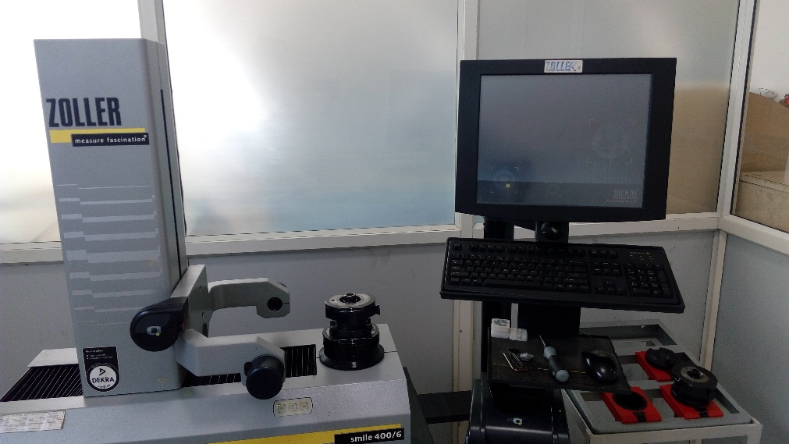
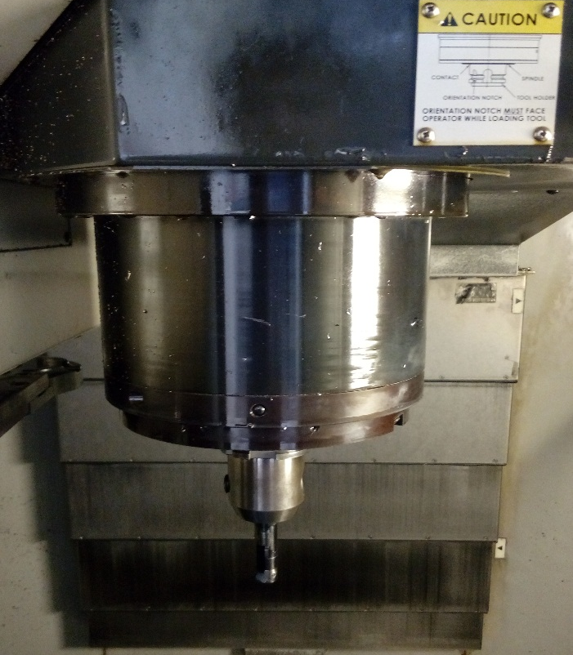


BASIC DATA FLOW METHOD
QR CODE READER
CONFIRM TOOL NUMBER PRESENCE TO SERVER
INTERFACE
Tool data storage and application server
Machining tool presetting instrument with computer interface
CONFIRMED TOOL LENGTH OFFSET DATA TO MACHINE
FOCAS INTERFACE
m/c 1

Slide 5
HOW DATA WILL BE INSERTED ON FOOL PROOF MANNER
Each and every machine and tool will be QR coded(Quick Response code)
Upon each setting and tool change time operator needs to read the tool and machine
If the machine and tool match the Defined Tool and machine data will be inserted in Tool Geometry Automatically
The Same QR code will check the flow of Data from Zoller to our application server

Slide 6
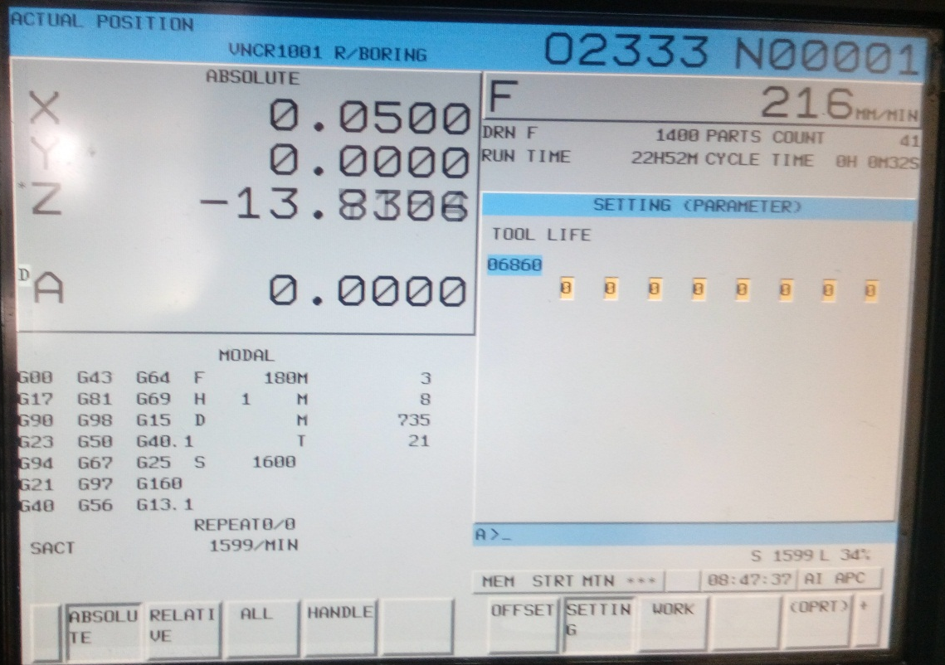
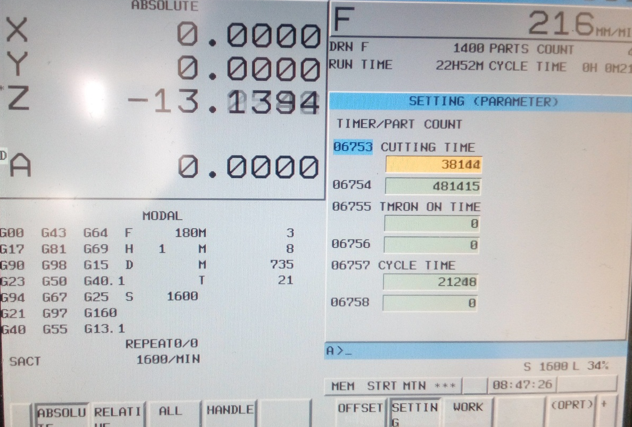
OTHER BENIFITS
TOOL LIFE MONITORING
CUTTING TIME AND CYCLE TIME MONITORING

